Slide 1
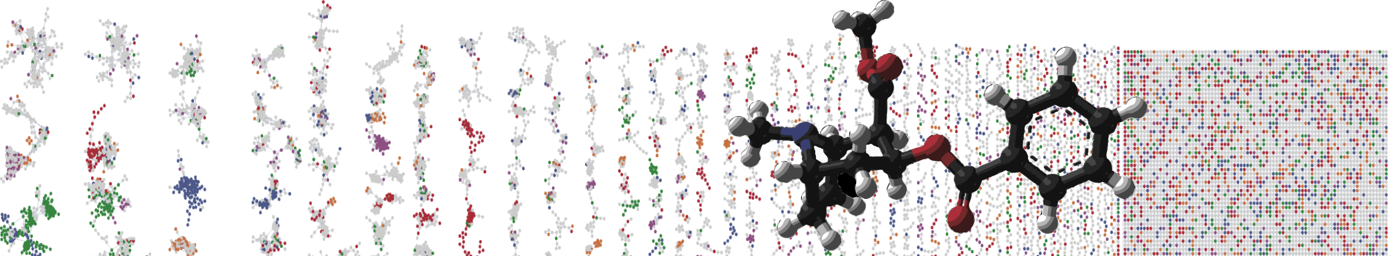


GNPS Classic Molecular Networking Job Submission
HANDS ON
ENTER AUTHORS HERE
University of California - San Diego

Slide 2
Objectives and Data
Create GNPS Account
Find Molecular Networking Workflow
Select Public Data to Analyze
Launch GNPS Molecular Networking Job
GNPS GF/SPF Demo Data - MSV000083437

Slide 3
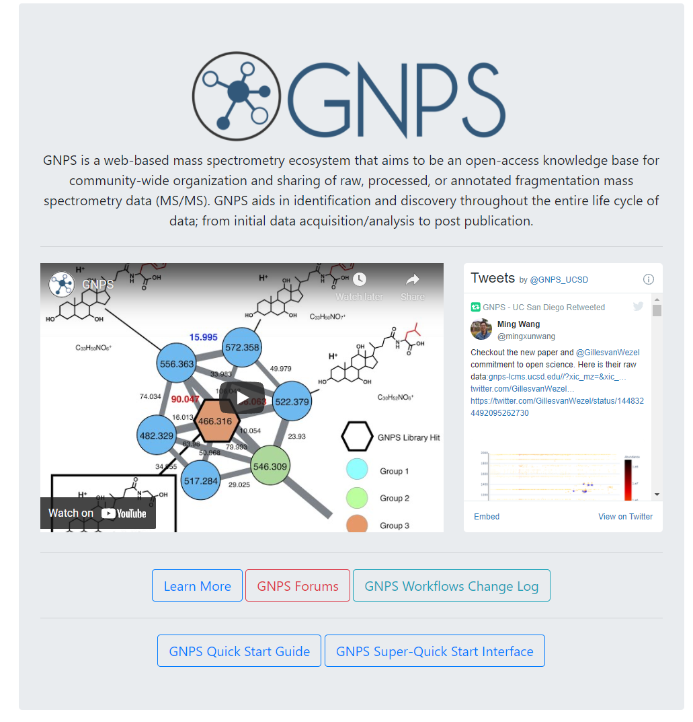
Go to GNPS (gnps.ucsd.edu)

Slide 4
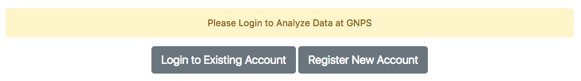
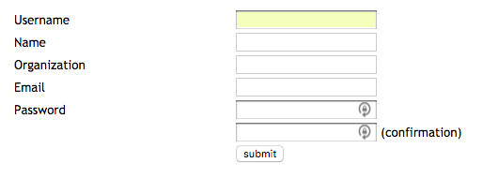
Create an Account

Slide 5
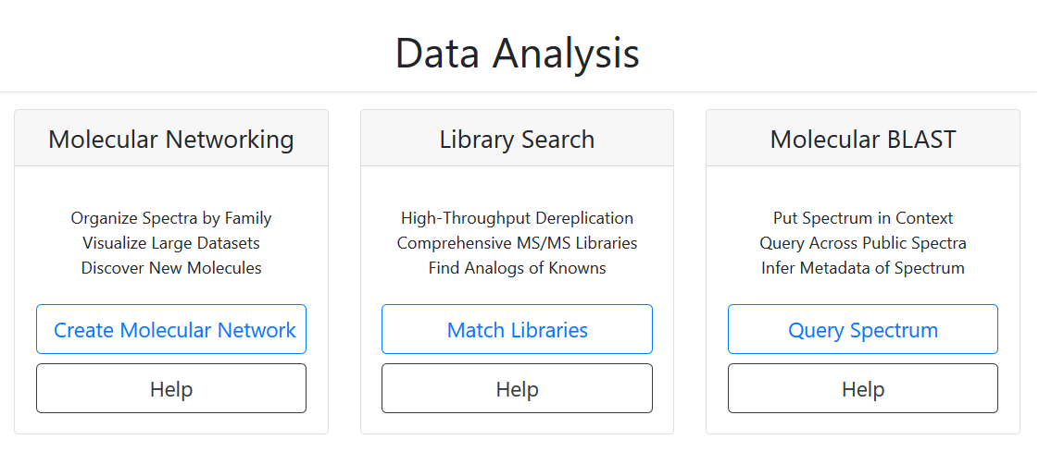
Select Molecular Networking

Slide 6
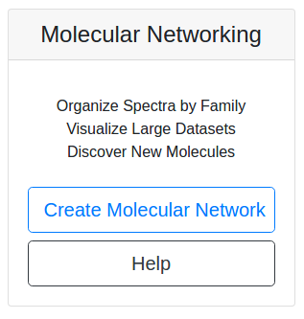
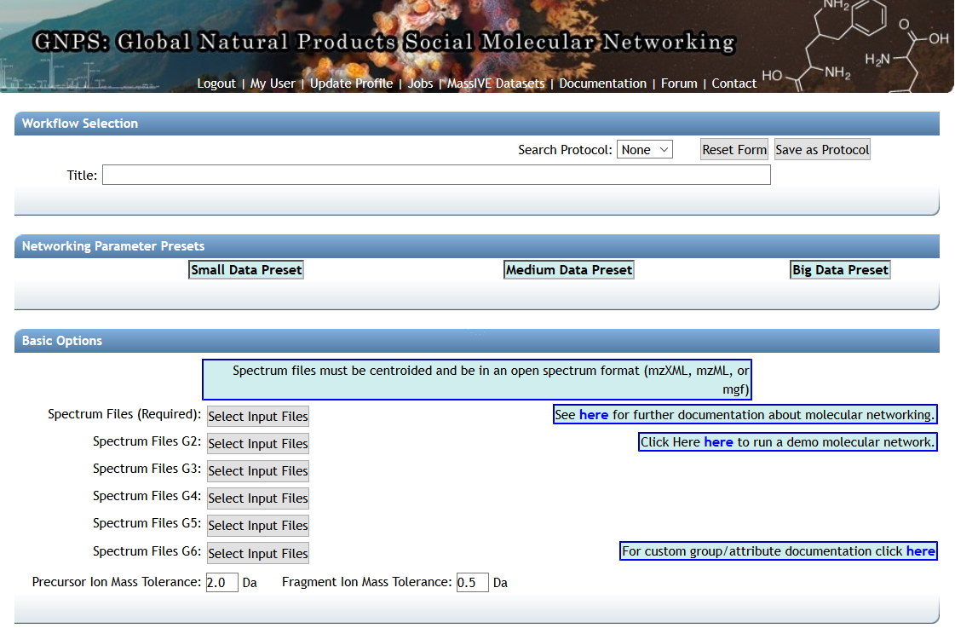
Select Molecular Networking

Slide 7
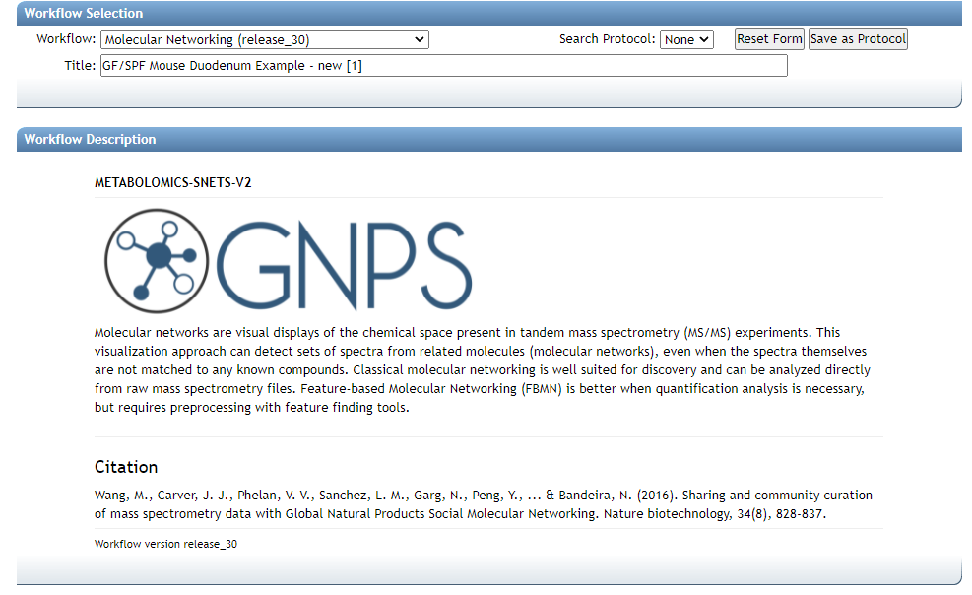

Enter Job Description
Prefilled Analysis

Slide 8
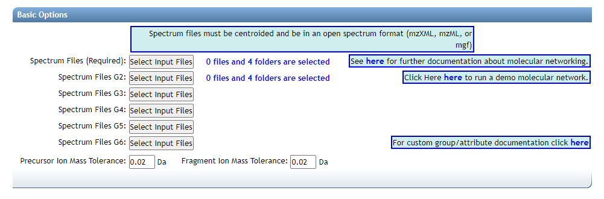
Select Input Files
Prefilled Analysis

Slide 9
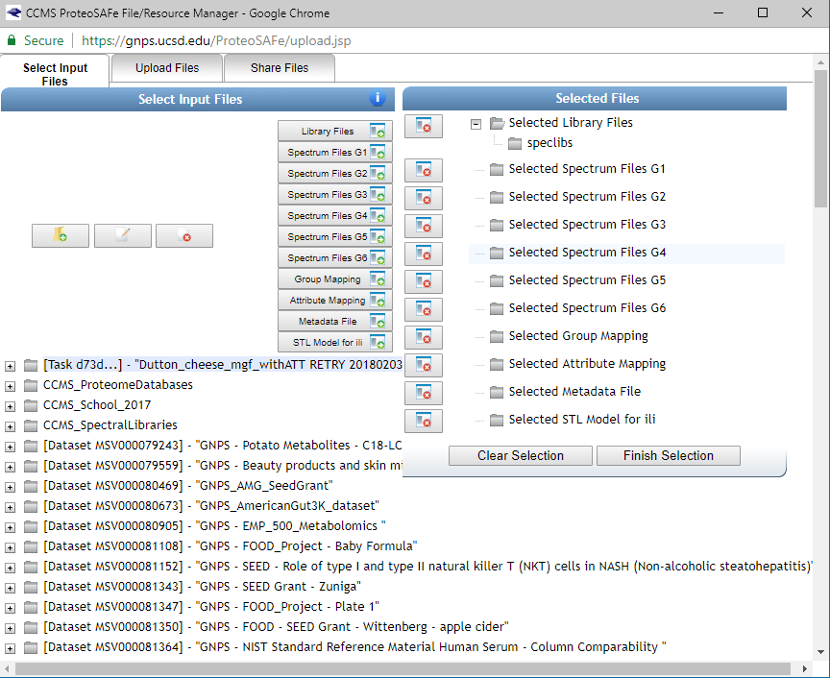
Import Public Data

Slide 10
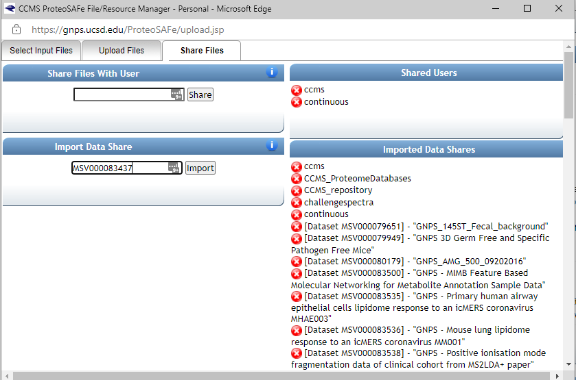
Import Public Data
MSV000083437
Click Import

Slide 11
Select Data To Analyze

Slide 12
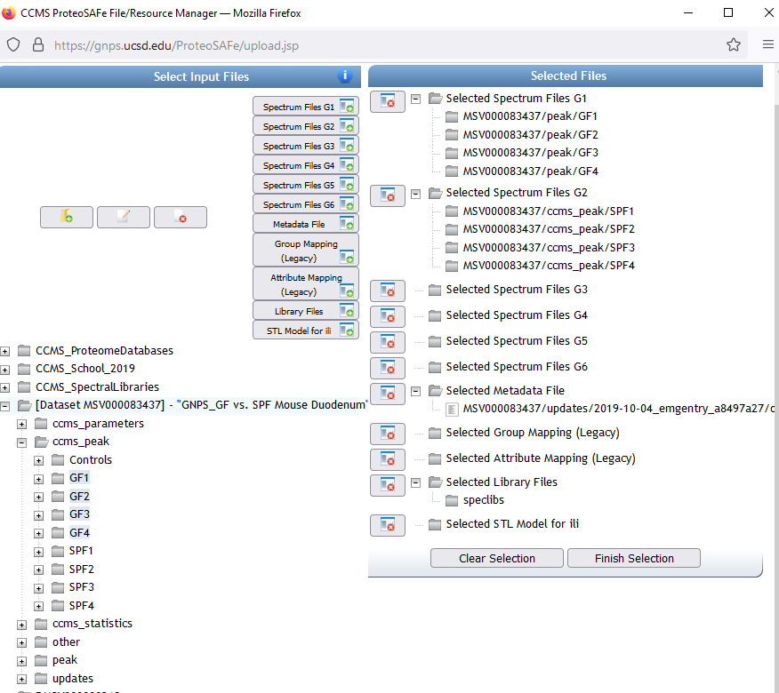
Select GF Samples
1

Slide 13
Select GF Samples
2
1

Slide 14
Select SPF Samples
1

Slide 15
Select SPF Samples
2
1

Slide 16
Finish Selection

Slide 17
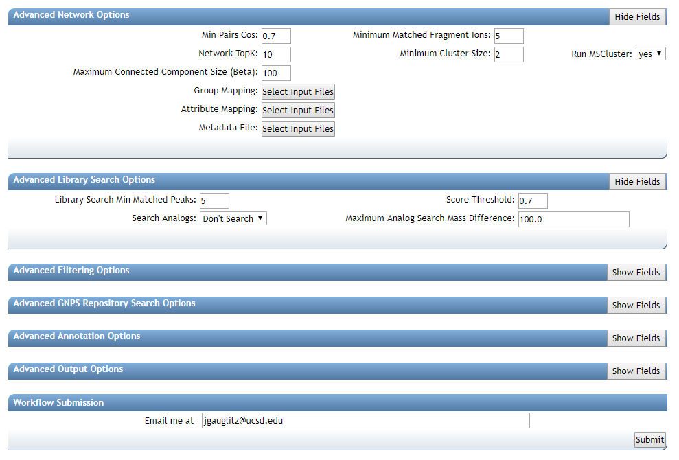
Prefilled Analysis
Notes:
5-10min to see if everyone got it?

Slide 18
Questions, Problems or Bugs?
Documentation: https://ccms-ucsd.github.io/GNPSDocumentation/
Forum: https://groups.google.com/forum/#!forum/molecular_networking_bug_reports
PRESENTER NAMES AND EMAILS HERE

